Slide 1
Welcome to
Backend Development (A25)

Slide 2

Agenda
Introductions 👋
Course overview & goals
Python and Git review 💻

Slide 3

1. Introductions
Notes:
https://teambuilding.com/blog/icebreaker-games-for-adults
https://toolbox.hyperisland.com/

Slide 4
2. Course overview & goals
Notes:
https://teambuilding.com/blog/icebreaker-games-for-adults
https://toolbox.hyperisland.com/

Slide 5
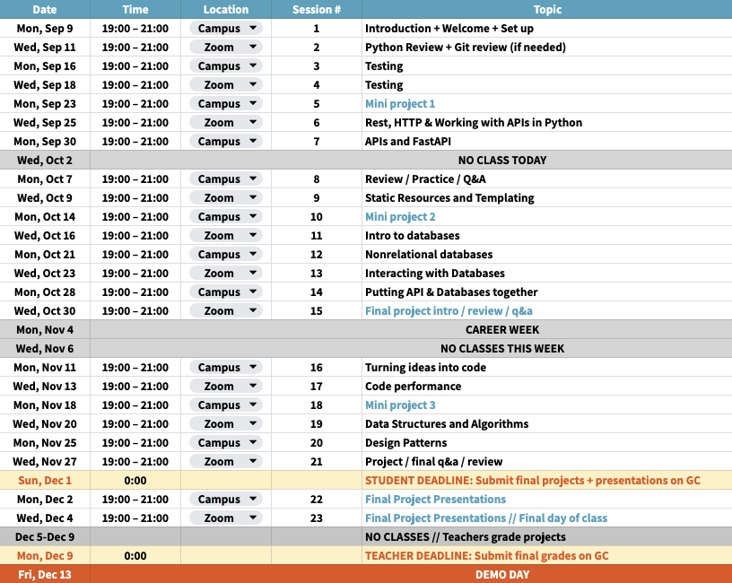
A look at this
semester

Slide 6
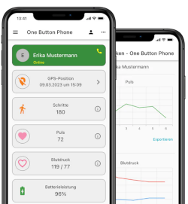

In this course, we will learn how to…
Create a Backend with Python
Use databases
Use common good practices and patterns
Backend
request
🚀
query
🔐
📊
response
results
Mobile app / Website
Python application
Database

Slide 7

In this course, we will learn by...
Designing and implementing RESTful APIs using FastAPI and MongoDB, including database schema design, query operations, and handling HTTP requests and responses
Securing an API with best practices for authentication and authorization
Optimizing the performance of APIs using caching techniques and understanding the benefits and limitations of different caching strategies
Applying common software design patterns to improve the maintainability and scalability of code

Slide 8

How to be successful
Come to class and participate
Follow along on your own device during demos/lectures
Be curious and ask questions (during lessons or anytime in slack )
Do the challenges and homework
For online class, cameras ON (or you will be marked as absent)
Submit and present a final project (details will come later in the semester)
Engage with Career Services
Attend 2 workshops
Complete 1 recommended module on the IBM SkillsBuild
See learner hub for details

Slide 9
3. Python & Git review 💻
Interactive
Notes:
https://teambuilding.com/blog/icebreaker-games-for-adults
https://toolbox.hyperisland.com/

Slide 10


Getting started - Tools
Python
Interpreted language
Simple grammar
Dynamic data type variables
Multi-platform
Widely used (updated documentation and constant fixes)
Git
Source control (also known as Version Control System)
Multi-platform
Widely used (updated documentation and constant fixes)

Slide 11
Getting started - Installation
Install Python and Git
Make Python and Git available in the $PATH environment variable
Install a code editor
Open a terminal

Slide 12
Getting started - Git configuration
Get Git installed version: $ git --version
Configure your identity:
$ git config --global user.email "you@example.com" (fill this with your email !)
$ git config --global user.name "your name" (fill this with your name !)
Corroborate configuration: $ git config --global --list

Slide 13
Getting started - Create a local git repository
Create a new directory: $ mkdir -p ~/Codes/lesson_1 && cd ~/Codes/lesson_1
Create a local git repository in the current directory: $ git init --initial-branch main
Create first content:
$ echo "Lesson 1" >> README.md
$ curl https://raw.githubusercontent.com/github/gitignore/master/Python.gitignore >> .gitignore
A well maintained ignored file for Python, which includes the virtual environment directory
List new files: $ git status (it should not be empty !)
Initialize the repository: $ git add --all (this will include .gitignore and README.md)
First commit: $ git commit -m "chore: initialize repository"
List all the commits: $ git log

Slide 14
Getting started: Python configuration
Get Python installed version: $ python3 --version
Create a virtual environment: $ python3 -m venv venv (it will create the directory venv)
Activate the virtual environment: $ source ./venv/bin/activate (to deactivate: $ deactivate)
Once the virtual environment is activated, we can use the python command instead of python3
Get pip installed version: $ python -m pip --version
List the installed packages: $ python -m pip freeze (it should be empty !)
Install a package with pip: $ python -m pip install pytest
List again the install packages: $ python -m pip freeze (it should not be empty !)
Store of the installed packages: $ python -m pip freeze > requirements.txt

Slide 15
Getting started - Let’s develop
List uncommitted changes: $ git status (it should appear requirements.txt !)
Inspect uncommitted changes: $ git diff
List all git branches: $ git branch -vv
Create a new branch: $ git branch feature/lesson-1
Track installed packages: $ git add requirements.txt
Commit changes: $ git commit -m "feature: track Python requirements"
List all commits: $ git log

Slide 16
Getting started - done!
We have everything to start 🚀

Slide 17
Python Recap
Data types
Operators
Loops
List comprehension
Functions
Lambda Expressions
Notes:
https://colab.research.google.com/drive/1VaKsJsaZTfrY88qVXwceQJJZ4c4B3IWo
Created by teacher from last semester

Slide 18
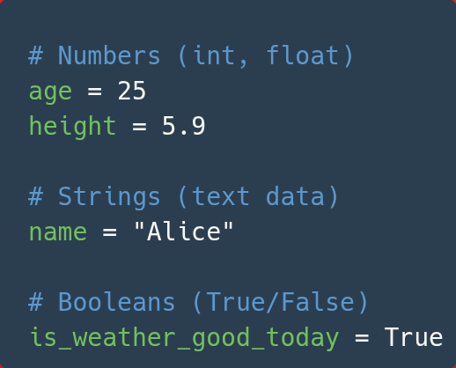
Python Recap: Primitive Data Types
Notes:
https://colab.research.google.com/drive/1VaKsJsaZTfrY88qVXwceQJJZ4c4B3IWo
Created by teacher from last semester

Slide 19
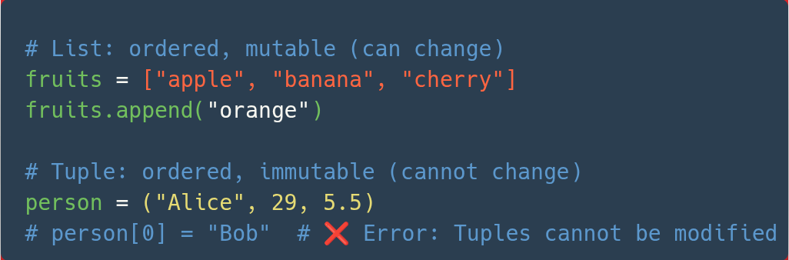
Python Recap: Lists and Tuples
Notes:
https://colab.research.google.com/drive/1VaKsJsaZTfrY88qVXwceQJJZ4c4B3IWo
Created by teacher from last semester

Slide 20
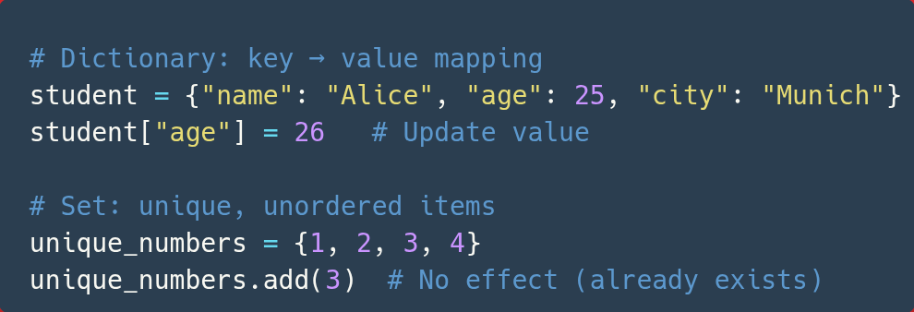
Python Recap: Dictionaries and Sets
Notes:
https://colab.research.google.com/drive/1VaKsJsaZTfrY88qVXwceQJJZ4c4B3IWo
Created by teacher from last semester

Slide 21
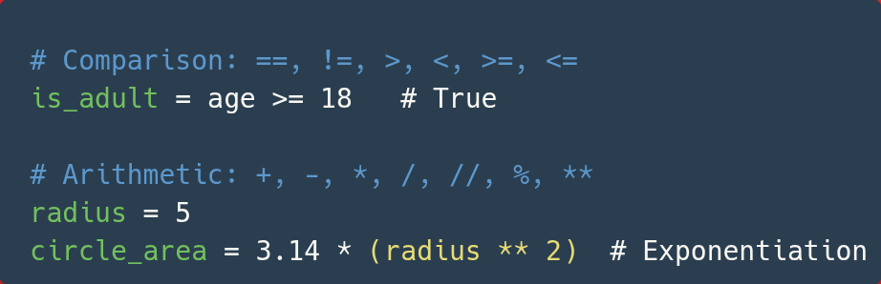
Python Recap: Arithmetic and Comparison
Notes:
https://colab.research.google.com/drive/1VaKsJsaZTfrY88qVXwceQJJZ4c4B3IWo
Created by teacher from last semester

Slide 22
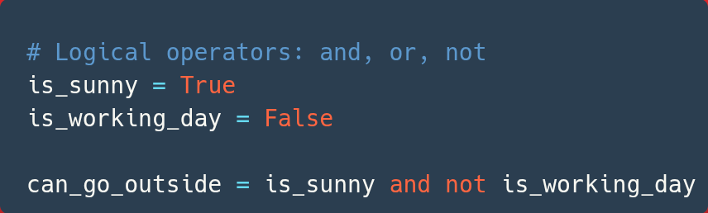
Python Recap: Logical Operators
Notes:
https://colab.research.google.com/drive/1VaKsJsaZTfrY88qVXwceQJJZ4c4B3IWo
Created by teacher from last semester

Slide 23
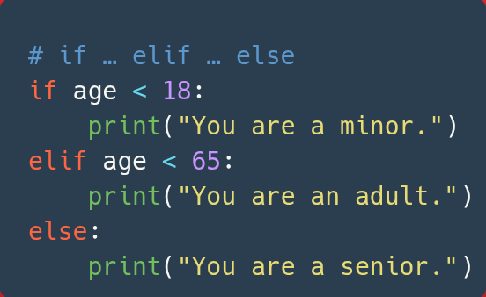
Python Recap: Conditional Statements
Notes:
https://colab.research.google.com/drive/1VaKsJsaZTfrY88qVXwceQJJZ4c4B3IWo
Created by teacher from last semester

Slide 24
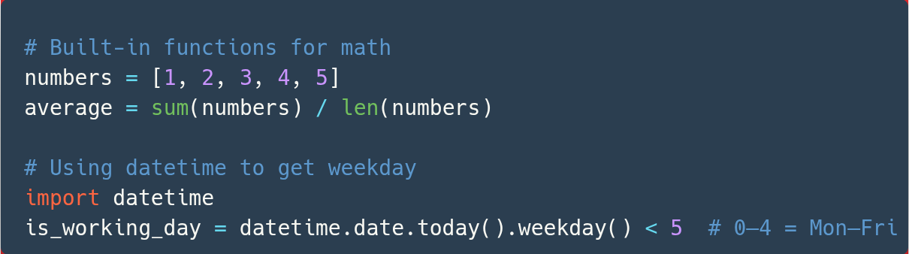
Python Recap: Using Functions
Notes:
https://colab.research.google.com/drive/1VaKsJsaZTfrY88qVXwceQJJZ4c4B3IWo
Created by teacher from last semester

Slide 25
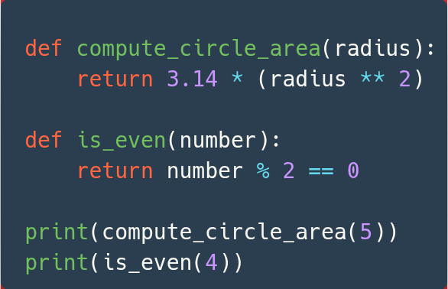
Python Recap: Defining Functions
Notes:
https://colab.research.google.com/drive/1VaKsJsaZTfrY88qVXwceQJJZ4c4B3IWo
Created by teacher from last semester

Slide 26
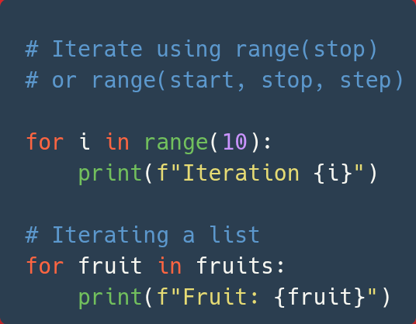
Python Recap: Iterating with for
Notes:
https://colab.research.google.com/drive/1VaKsJsaZTfrY88qVXwceQJJZ4c4B3IWo
Created by teacher from last semester

Slide 27
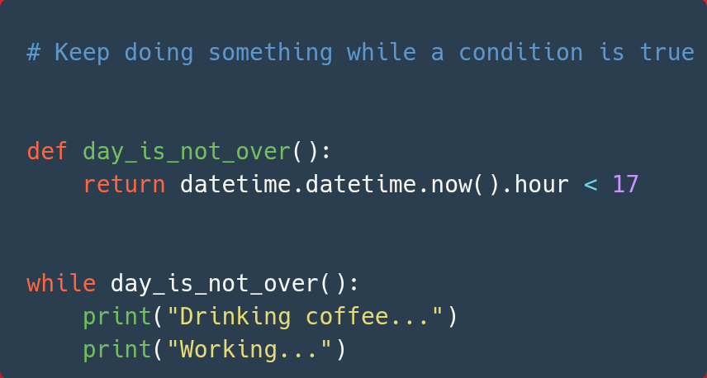
Python Recap: Looping with while
Notes:
https://colab.research.google.com/drive/1VaKsJsaZTfrY88qVXwceQJJZ4c4B3IWo
Created by teacher from last semester

Slide 28
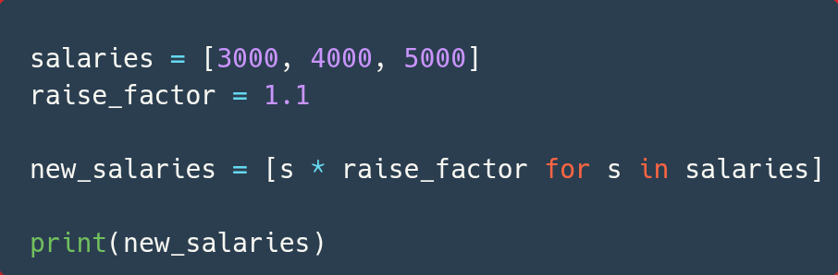
Python Recap: List Comprehension
Notes:
https://colab.research.google.com/drive/1VaKsJsaZTfrY88qVXwceQJJZ4c4B3IWo
Created by teacher from last semester

Slide 29
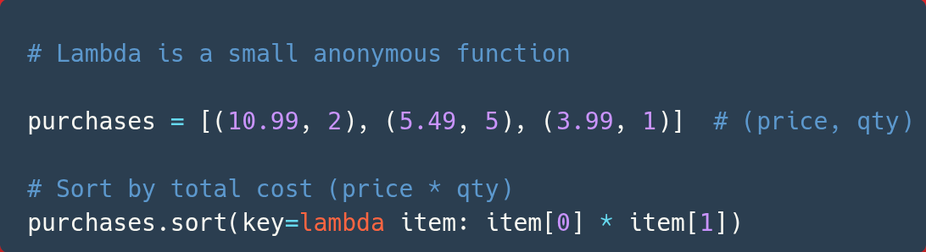
Python Recap: Lambdas
Notes:
https://colab.research.google.com/drive/1VaKsJsaZTfrY88qVXwceQJJZ4c4B3IWo
Created by teacher from last semester

Slide 30
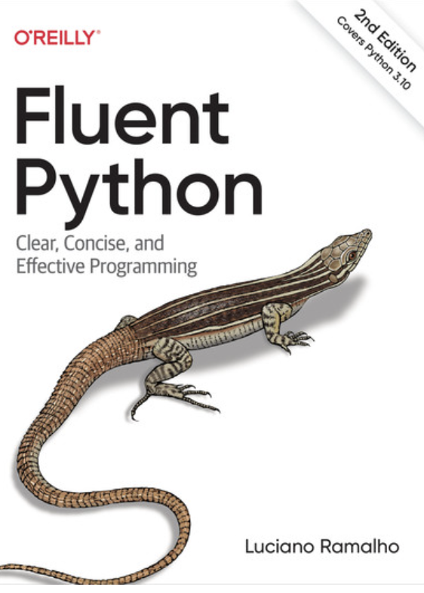

Links and further materials
Books!
Fluent Python - Luciano Ramalho
Pro Git - Scott Chacon
Git Book - https://git-scm.com/book/en/v2 free and in many languages
Links!
Python tutorial https://docs.python.org/3/tutorial
Python turtle https://docs.python.org/3/library/turtle.html
Conventional commits https://www.conventionalcommits.org
Videos!
Pretty recent setup of pip and venv in VS Code : https://youtu.be/GZbeL5AcTgw
Install git on Windows: https://www.youtube.com/results?search_query=installing+git+on+windows+11

Slide 31
Homework
Voluntary but good way to get some practice!
Fork a repository: e.g., https://github.com/bkircher/intro-python
Create a PR or comment on one: e.g., https://github.com/bkircher/intro-python/pull/1
Check out your favourite Open Source project and look how people do report issues, create pull requests, and look out for a CONTRIBUTING.md (https://en.wikipedia.org/wiki/Contributing_guidelines) or labels like “good-first-time-contribution”
Bonus points:
Refresh your Python and git skills: Create a new empty repository, push to your own GitHub/Gitlab, write a script named echo.py that reads continuously from STDIN into a variable and writes it back to STDOUT again. Ctrl+C should exit the script. Share link to your repository in Slack with the others!
Hints: use input() built-in function to read from STDIN, use print() built-in function to output on STDOUT, use while True for an endless loop and check out KeyboardInterrupt exception!
Links:
https://docs.python.org/3/library/functions.html
https://docs.python.org/3/library/exceptions.html#Exception

Slide 32
Thank You !

